Slide 1
Human Computer Interaction
Prototyping

Slide 2
Prototyping
What is a prototype?
Why prototype?
Evolutionary vs. throwaway prototype
Low vs. high fidelity prototyping

Slide 3
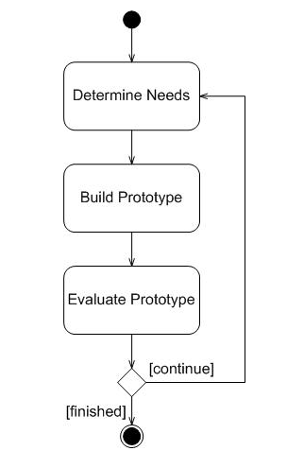
Prototype
A prototype is an early sample, model, or release of a product built to test a concept or process or to act as a thing to be replicated or learned from

Slide 4

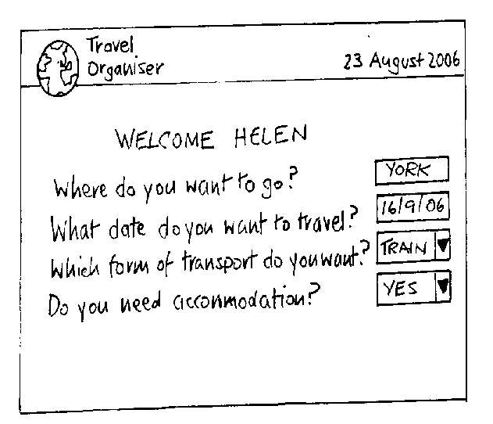
What is a prototype?
Limited representation of a product design
Scale models, etc.
In interaction design it can be (among other things):
  a series of screen sketches
  a storyboard, i.e. a cartoon-like series of scenes
  a piece of software with limited functionality
Notes:
The most familiar scale models represent the physical appearance of an object in miniature,

Slide 5
Why prototype?
People cannot describe what they want, but they are quick to recognize what they do not like!
Makes requirements, designs and specifications into concrete tangible objects for evaluation

Slide 6
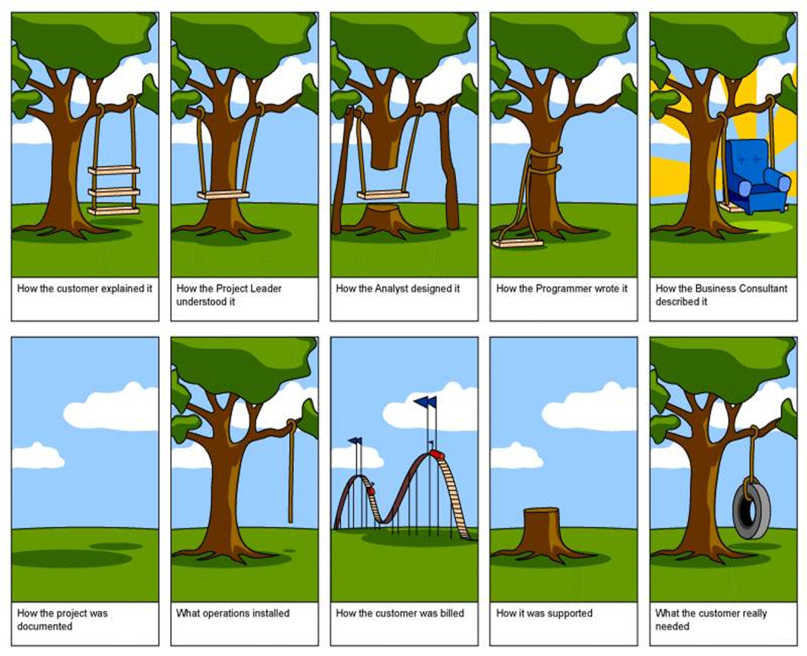
Why prototype?
Notes:
Makes requirements, designs and specifications into concrete tangible objects for evaluation

Slide 7
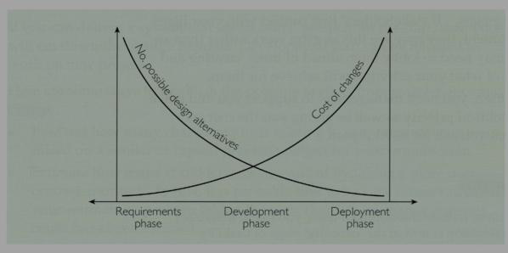
Why prototype?

Slide 8
Why prototype?
Evaluation and feedback are central to interaction design
Stakeholders can see, hold, interact with a prototype more easily than with a document
Clarifies vague requirements with concrete communication between stakeholders & team
Team members can communicate effectively
It encourages reflection
Prototypes answer questions, and support designers in choosing between alternatives
Sells product ideas
Notes:
Interactive exploration with envisioned product
Clarifies vague requirements with concrete communication between stakeholders
supports design decisions with forced reflection
Tests feasibility & compatibility
Sells product ideas

Slide 9
What to prototype?
Work flow, task design, sequence i.e. in the order they happen
Screen layouts and information display i.e. icons, home buttons, back buttons, colors etc.
Critical areas i.e. Undo button, help, exit, stop etc.
Every thing you need to convey the product experience (but no more)

Slide 10
Prototyping Techniques
Throw away prototyping (rapid prototyping)
  Prototype developed as part of a throw-away approach
Evolutionary prototyping
  as for incremental prototyping but with evolving design

Slide 11
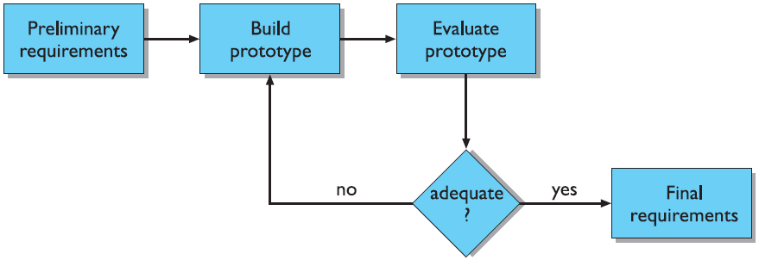
Throw-away / Rapid Prototyping
Prototype developed as part of a throw-away approach.
It will not form part of the final solution.
It is a useful way of exploring ideas, and gaining feedback from user.

Slide 12
Evolutionary Prototyping
An initial prototype is presented to user.
They provide feedback and suggestion for improvement.
Each stage of this prototype evolves toward the final system hence it is called as evolutionary prototype.

Slide 13
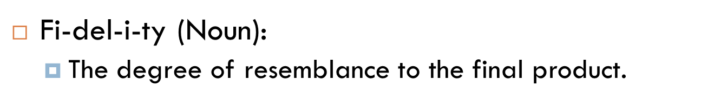
Prototype fidelity
Low fidelity
High fidelity
Quick, cheap, easily changed
Paper based
  Sketches of screens with post-it notes (task sequences)
  Card-based
  Storyboards
Is usually computer based
Prototype looks more like the final system than a low-fidelity version.
Usually include mouse/keyboard interaction

Slide 14
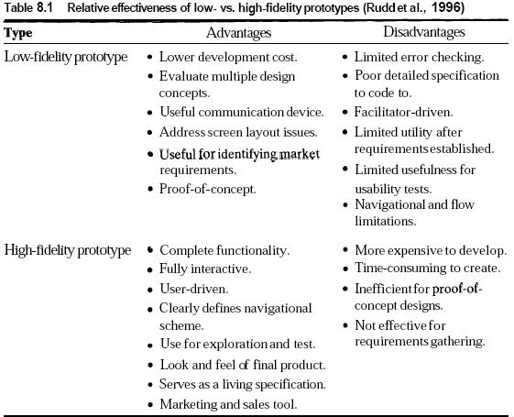
Prototype fidelity

Slide 15
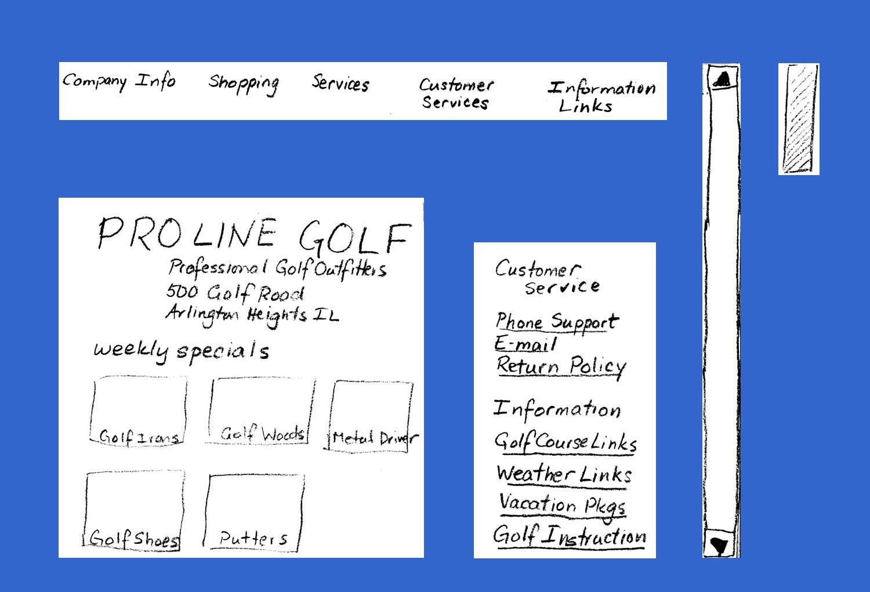
Low fidelity: An Example
Menu Bar
Scroll
Bar
Opening Contents
Secondary Menu

Slide 16
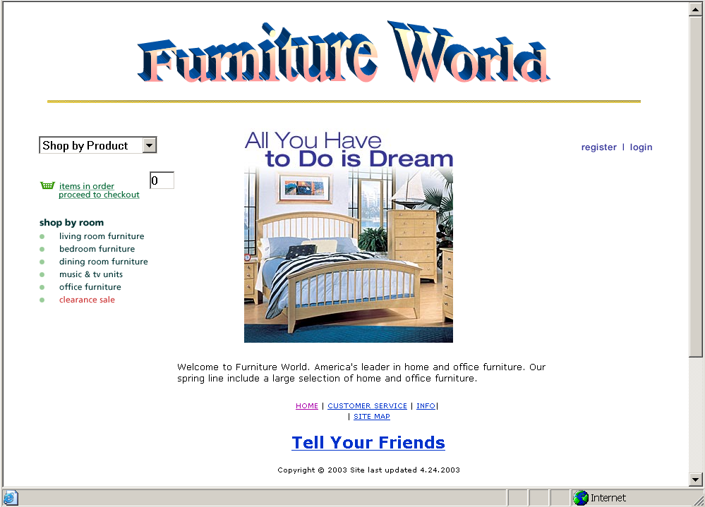
High fidelity: An Example

Slide 17
Why lo-fi is often better than hi-fi
At least in the early stages of design…
  Hi-fi prototypes can be problematic
    users can often think it’s the real thing
    users tend to focus on small details (e.g. font size) rather than the bigger picture
    developers get over-attached having done the programming
  Lo-fi prototypes avoid these issues...
    easy to change
    users concentrate on big picture (e.g. structure and function)
    it’s disposable
So before investing in hi-fi, we need to get lo-fi versions right

Slide 18
Sketching
Sketching is important to low-fidelity prototyping
Don’t be self-conscious about drawing ability. Practice simple symbols

Slide 19
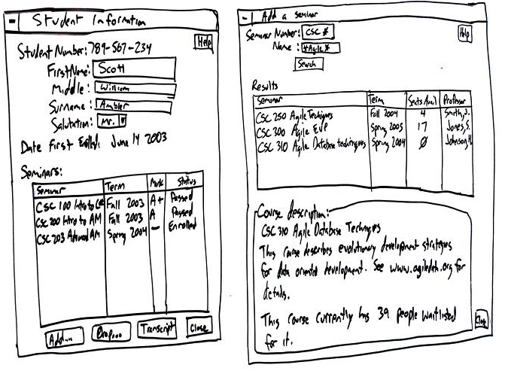

Slide 20
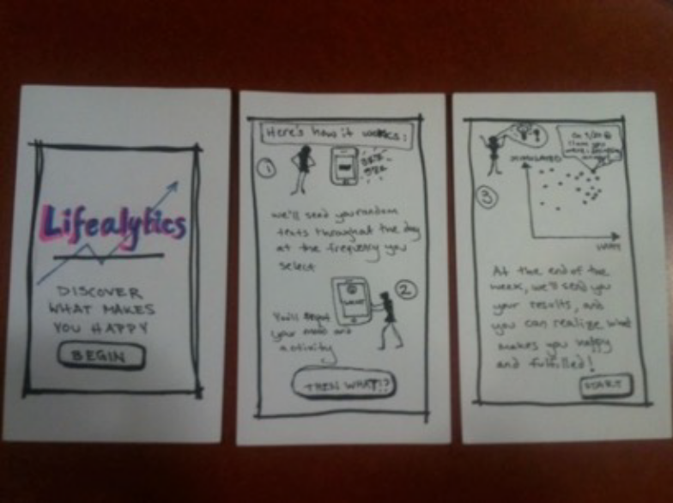
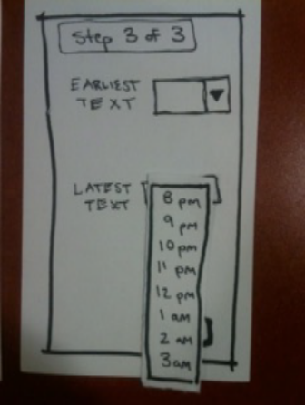
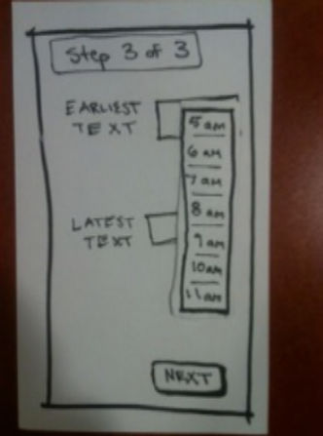
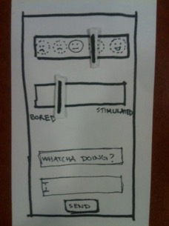
Paper prototyping

Slide 21
Resources
https://www.youtube.com/watch?v=dt1bQsZ68iw
https://www.youtube.com/watch?v=B7M0fVXdovM
https://www.youtube.com/watch?v=EHCX1rt02Co

Slide 22
Eight Golden Rules of Interface Design
1 Strive for consistency.
Consistent sequences of actions should be required in similar situations; identical terminology should be used in prompts, menus, and help screens; and consistent colors should be used throughout
2 Enable frequent users to use shortcuts.
As the frequency of use increases, so do the user's desires to reduce the number of interactions and to increase the pace of interaction. Abbreviations, function keys, shortcuts are very helpful to an expert user.

Slide 23
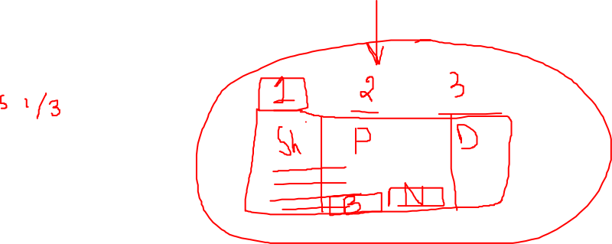
Eight Golden Rules of Interface Design
3 Offer informative feedback.​
For every operator action, there should be some system feedback.
4 Design dialog to yield closure.​
Sequences of actions should be organized into groups with a beginning, middle, and end.

Slide 24
Eight Golden Rules of Interface Design
5 Offer simple error handling.
As much as possible, design the system so the user cannot make a serious error. If an error is made, the system should be able to detect the error and offer simple, comprehensible mechanisms for handling the error.
6 Permit easy reversal of actions.
This feature relieves anxiety, since the user knows that errors can be undone; it thus encourages exploration of unfamiliar options.

Slide 25
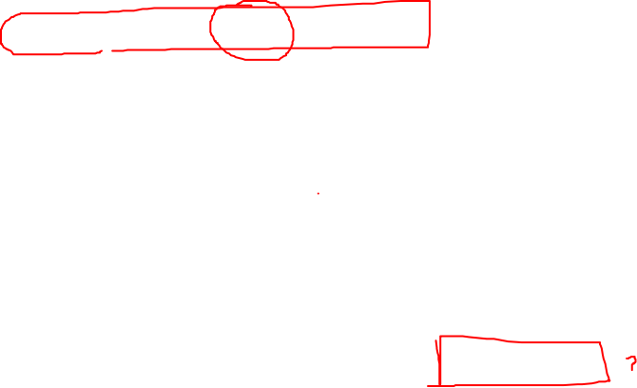
7 Support internal locus of control.
Experienced operators strongly desire the sense that they are in charge of the system and that the system responds to their actions. Design the system to make users the initiators of actions rather than the responders.
  Navigation & task activation should always be clear and well-marked.
  Things as simple as adding an extra keystroke or button press can make a great difference when looking at tasks that are life critical.
8 Reduce short-term memory load.
The limitation of human information processing in short-term memory requires that displays be kept simple and helpful.

Slide 26
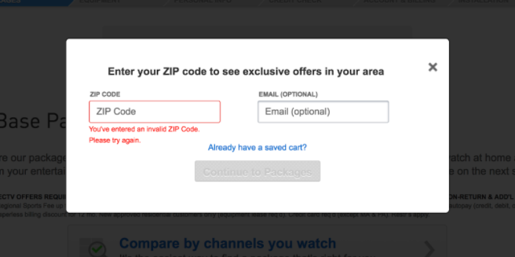
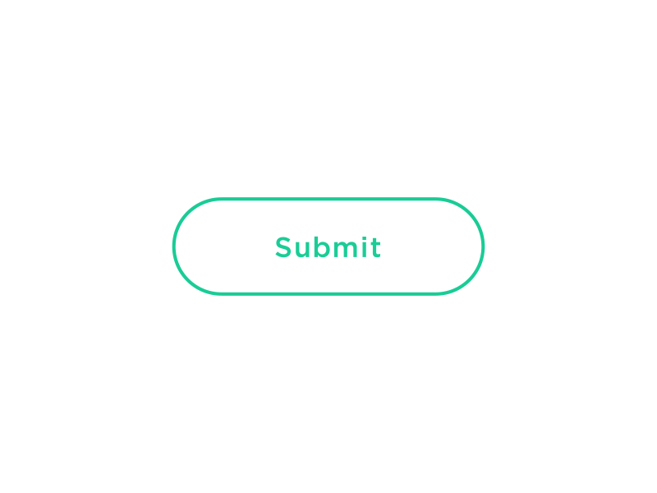
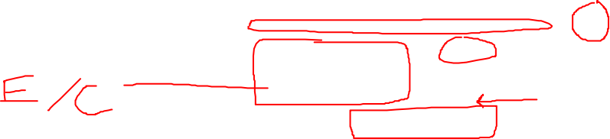
Example of feedback & communication

Slide 27
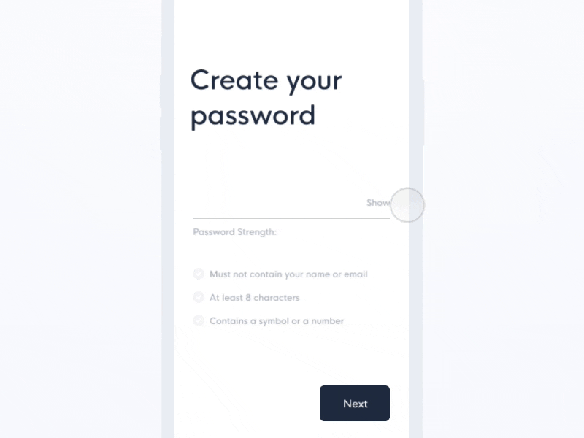
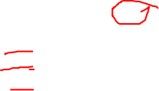

Slide 28
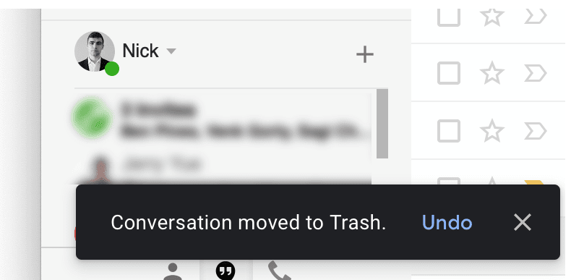

Example: Easy use of reversal

Slide 29
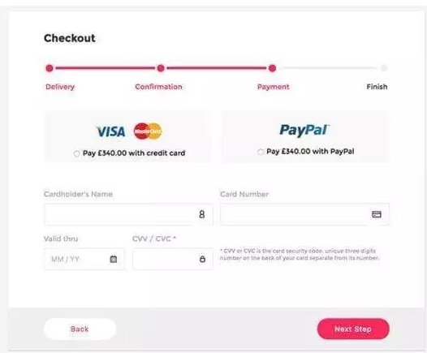
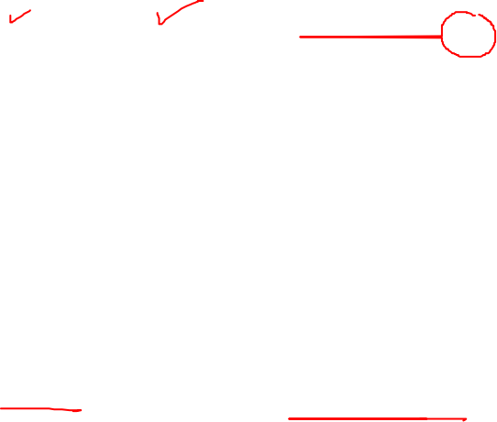
Example: internal locus of control

Slide 30
Tips
Keep the interface simple. The best interfaces are almost invisible to the user. They avoid unnecessary elements and are clear in the language they use on labels and in messaging
Strategically use color and texture. You can direct attention toward or redirect attention away from items using color, light, contrast, and texture to your advantage
Add default values to help lessen user burden
Carefully choose font style and size so that it is readable.

Slide 31
Some useful resources to choose color
https://www.smashingmagazine.com/2010/02/color-theory-for-designer-part-3-creating-your-own-color-palettes/
https://www.smashingmagazine.com/2016/04/web-developer-guide-color/

Slide 32


There’s no need to reinvent the wheel. What interfaces do your users spend the majority of their time on? Considering using popular interfaces, such as Facebook, Instagram, Google and Gmail as UI design examples to help solve similar issues on your interface. Users will appreciate the familiarity and simplicity of those UI patterns

Slide 33
How to start – make lo-fi
Technique: Sketching
Design a simple logo
Design sign up Page
Design Sign in Page
Design Main/Home page
Design Menu/Side pane
  Add main tasks in it
  Add log out button
  Add help
  Add feed back
  Design profile page
Design task pages (Divide this evenly in all group members)
  Add default values (if some input is being taken)
  Add navigation where necessary
  Design error message screens
  Design confirmation message screens

Slide 34
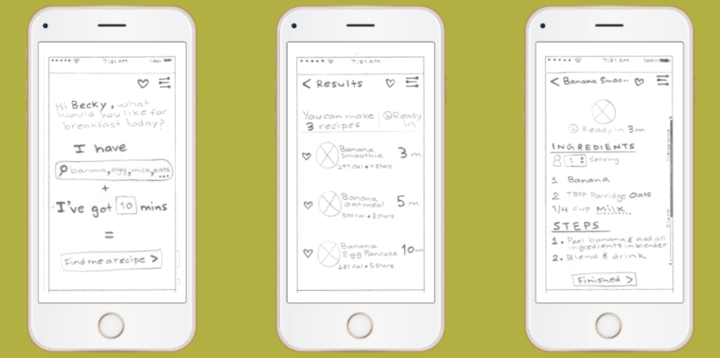

Slide 35
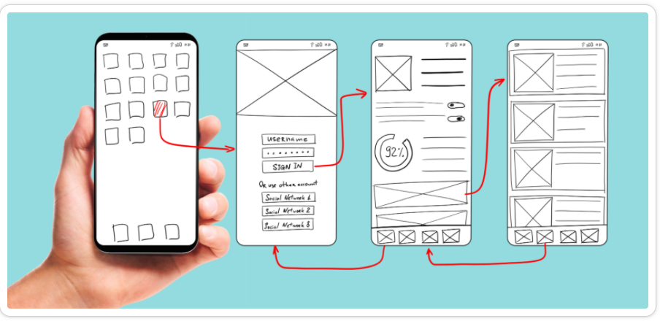

Slide 36
Lo fidelity technique 2: Storyboarding.
It is about conveying an idea.​
Often used with scenarios, bringing more detail, and a chance to role play​
It is a series of sketches showing how a user might progress through a task using the device ​

Slide 37
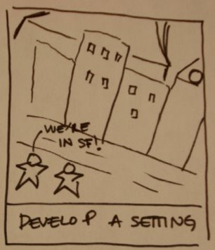
Storyboards should convey - setting​
People involved​
Environment​
Task being accomplished

Slide 38
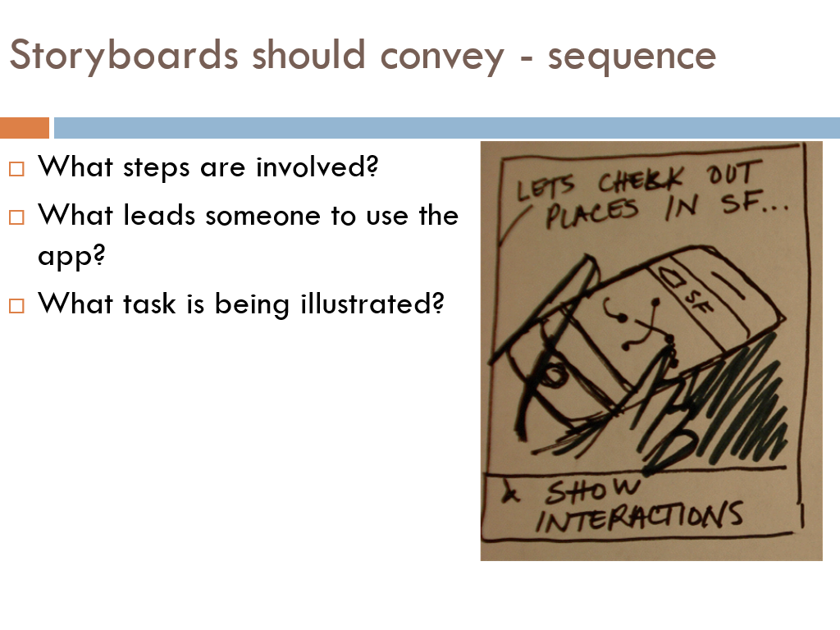

Slide 39
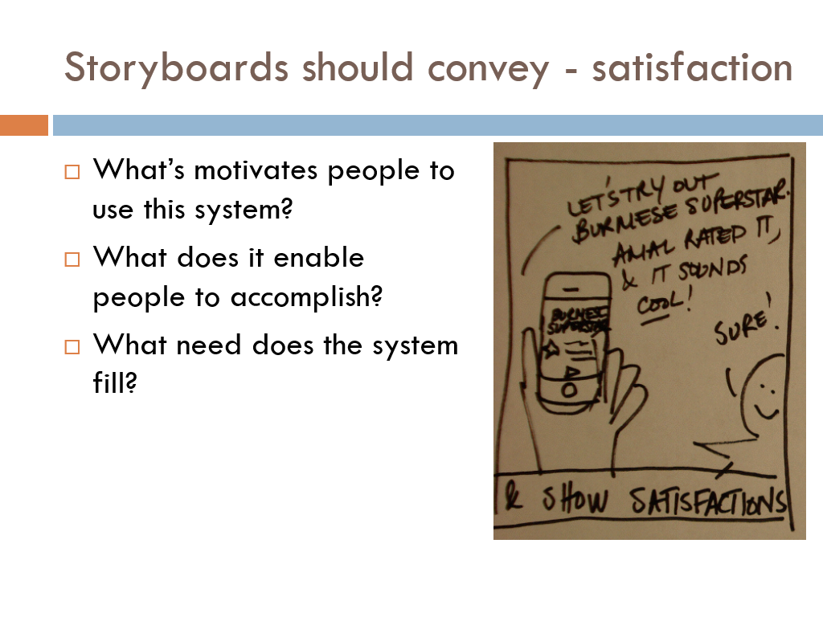

Slide 40
Sample scenario
“The Thomson family enjoy outdoor activity holidays and want to try their hand at sailing this year. There are four members of the family: Sky who is 10 years old, Eamonn who is 15 years old, Claire who is 35, and Will who is 40. While out on a shopping trip they call by at the travel agents in their local town to start exploring the possibilities. The travel organizer is located in a quiet corner of the agents’ office, where there are comfortable seats and play things for young children. They all gather around the organizer and enter their initial set of requirements—a sailing holiday for four novices. The stand-alone console is designed so that all members of the family can interact easily and comfortably with it. The system’s initial suggestion is that they should consider a flotilla holiday, where several novice crews go sailing together and provide mutual support for first-time sailors…”

Slide 41
